Slide 1
332:479 Concepts in VLSI
Design
Lecture 19
Introduction to Testing
Definition of testing
Automatic Test Equipment
Fault Models
Event-Driven Logic Simulation
Summary
Michael Bushnell and David Harris
Rutgers U. and Harvey Mudd College

Slide 2
Source: “Essentials of Testing for Logic, Memory, and Mixed-Signal Circuits”
by Bushnell & Agrawal, Kluwer Academic Press, 2000

Slide 3
VLSI Realization Process
Customer’s need
Determine requirements
Write specifications
Design synthesis and Verification
Test development
Fabrication
Manufacturing test
Chips to customer

Slide 4
Definitions
Design synthesis: Given an I/O function, develop a procedure to manufacture a device using known materials and processes.
Verification: Predictive analysis to ensure that the synthesized design, when manufactured, will perform the given I/O function.
Test: A manufacturing step that ensures that the physical device, manufactured from the synthesized design, has no manufacturing defect.

Slide 5
Real Tests
Based on analyzable fault models, which may not map on real defects.
Incomplete coverage of modeled faults due to high complexity.
Some good chips are rejected. The fraction (or percentage) of such chips is called the yield loss.
Some bad chips pass tests. The fraction (or percentage) of bad chips among all passing chips is called the defect level.

Slide 6
Costs of Testing
Design for testability (DFT)
  Chip area overhead and yield reduction
  Performance overhead
Software processes of test
  Test generation and fault simulation
  Test programming and debugging
Manufacturing test
  Automatic test equipment (ATE) capital cost
  Test center operational cost

Slide 7
Cost of Manufacturing Testing in 2000AD
0.5-1.0GHz, analog instruments,1,024 digital pins: ATE purchase price
  = $1.2M + 1,024 x $3,000 = $4.272M
Running cost (five-year linear depreciation)
  = Depreciation + Maintenance + Operation
  = $0.854M + $0.085M + $0.5M
  = $1.439M/year
Test cost (24 hour ATE operation)
  = $1.439M/(365 x 24 x 3,600)
  = 4.5 cents/second

Slide 8
VLSI Testing Process and Equipment

Slide 9
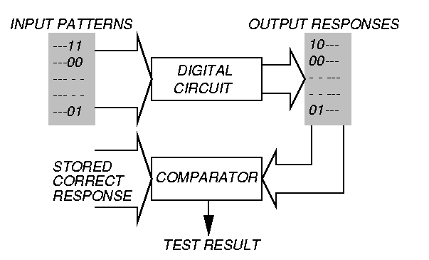
Testing Principle

Slide 10
Testing
Testing is one of the most expensive parts of chips
  Logic verification accounts for > 50% of design effort for many chips
  Debug time after fabrication has enormous opportunity cost
  Shipping defective parts can sink a company
Example: Intel FDIV bug
  Logic error not caught until > 1M units shipped
  Recall cost $450M (!!!)

Slide 11
Logic Verification
Does the chip simulate correctly?
  Usually done at HDL level
  Verification engineers write test bench for HDL
    Can’t test all cases
    Look for corner cases
    Try to break logic design
Ex: 32-bit adder
  Test all combinations of corner cases as inputs:
    0, 1, 2, 2³¹-1, -1, -2³¹, a few random numbers
Good tests require ingenuity

Slide 12
Silicon Debug
Test the first chips back from fabrication
  If you are lucky, they work the first time
  If not…
Logic bugs vs. electrical failures
  Most chip failures are logic bugs from inadequate simulation
  Some are electrical failures
    Crosstalk
    Dynamic nodes: leakage, charge sharing
    Ratio failures
  A few are tool or methodology failures (e.g. DRC)
Fix the bugs and fabricate a corrected chip

Slide 13
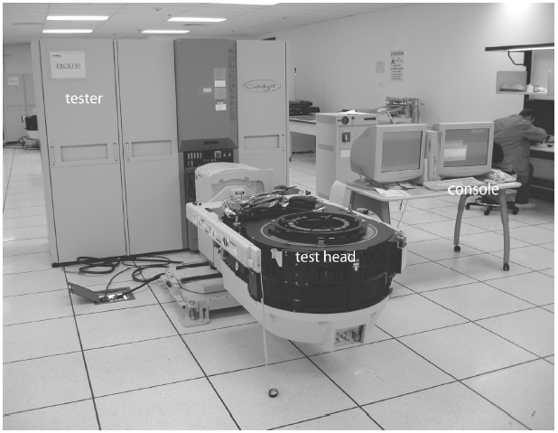
Manufacturing Test
A speck of dust on a wafer is sufficient to kill chip
Yield of any chip is < 100%
  Must test chips after manufacturing before delivery to customers to only ship good parts
Manufacturing testers are
very expensive
  Minimize time on tester
  Careful selection of
  test vectors

Slide 14
Stuck-At Faults
How does a chip fail?
  Usually failures are shorts between two conductors or opens in a conductor
  This can cause very complicated behavior
A simpler model: Stuck-At
  Assume all failures cause nodes to be “stuck-at” 0 or 1, i.e. shorted to GND or V_{DD}
  Not quite true, but works well in practice

Slide 15
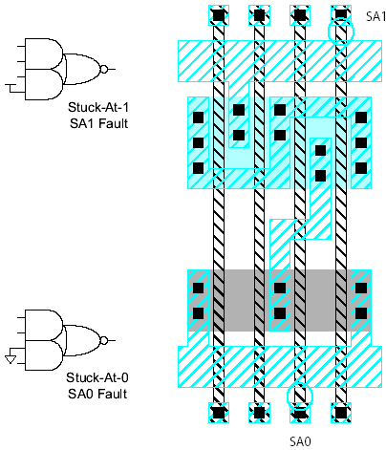
Examples

Slide 16
Observability & Controllability
Observability: ease of observing a node by watching external output pins of the chip
Controllability: ease of forcing a node to 0 or 1 by driving input pins of the chip
Combinational logic is usually easy to observe and control
Finite state machines can be very difficult, requiring many cycles to enter desired state
  Especially if state transition diagram is not known to the test engineer

Slide 17
Test Pattern Generation
Manufacturing test ideally would check every node in the circuit to prove it is not stuck.
Apply the smallest sequence of test vectors necessary to prove each node is not stuck.
Good observability and controllability reduces number of test vectors required for manufacturing test.
  Reduces the cost of testing
  Motivates design-for-test

Slide 18
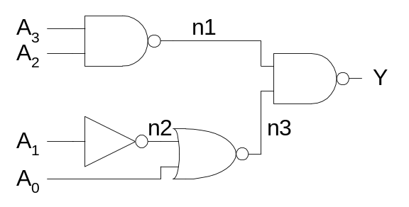
Test Example
    SA1 SA0
A₃
A₂
A₁
A₀
n1
n2
n3
Y
Minimum set:

Slide 19
Test Example
    SA1 SA0
A₃ {0110} {1110}
A₂
A₁
A₀
n1
n2
n3
Y
Minimum set:

Slide 20
Test Example
    SA1 SA0
A₃ {0110} {1110}
A₂ {1010} {1110}
A₁
A₀
n1
n2
n3
Y
Minimum set:

Slide 21
Test Example
    SA1 SA0
A₃ {0110} {1110}
A₂ {1010} {1110}
A₁ {0100} {0110}
A₀
n1
n2
n3
Y
Minimum set:

Slide 22
Test Example
    SA1 SA0
A₃ {0110} {1110}
A₂ {1010} {1110}
A₁ {0100} {0110}
A₀ {0110} {0111}
n1
n2
n3
Y
Minimum set:

Slide 23
Test Example
    SA1 SA0
A₃ {0110} {1110}
A₂ {1010} {1110}
A₁ {0100} {0110}
A₀ {0110} {0111}
n1 {1110} {0110}
n2
n3
Y
Minimum set:

Slide 24
Test Example
    SA1 SA0
A₃ {0110} {1110}
A₂ {1010} {1110}
A₁ {0100} {0110}
A₀ {0110} {0111}
n1 {1110} {0110}
n2 {0110} {0100}
n3
Y
Minimum set:

Slide 25
Test Example
    SA1 SA0
A₃ {0110} {1110}
A₂ {1010} {1110}
A₁ {0100} {0110}
A₀ {0110} {0111}
n1 {1110} {0110}
n2 {0110} {0100}
n3 {0101} {0110}
Y
Minimum set:

Slide 26
Test Example
    SA1 SA0
A₃ {0110} {1110}
A₂ {1010} {1110}
A₁ {0100} {0110}
A₀ {0110} {0111}
n1 {1110} {0110}
n2 {0110} {0100}
n3 {0101} {0110}
Y {0110} {1110}
Minimum set: {0100, 0101, 0110, 0111, 1010, 1110}

Slide 27
Design for Test
Design the chip to increase observability and controllability
If each register could be observed and controlled, test problem reduces to testing combinational logic between registers.
Better yet, logic blocks could enter test mode where they generate test patterns and report the results automatically.

Slide 28
Manufacturing Test
Determines whether manufactured chip meets specs
Must cover high % of modeled faults
Must minimize test time (to control cost)
No fault diagnosis
Tests every device on chip
Test at speed of application or speed guaranteed by supplier

Slide 29
Fault Modeling

Slide 30
Why Model Faults?
I/O function tests inadequate for manufacturing (functionality versus component and interconnect testing)
Real defects (often mechanical) too numerous and often not analyzable
A fault model identifies targets for testing
A fault model makes analysis possible
Effectiveness measurable by experiments

Slide 31
Some Real Defects in Chips
Processing defects
    Missing contact windows
    Parasitic transistors
    Oxide breakdown
    . . .
Material defects
    Bulk defects (cracks, crystal imperfections)
    Surface impurities (ion migration)
    . . .
Time-dependent failures
    Dielectric breakdown
    Electromigration
    . . .
Packaging failures
    Contact degradation
    Seal leaks
    . . .
Ref.: M. J. Howes and D. V. Morgan, Reliability and Degradation -
Semiconductor Devices and Circuits, Wiley, 1981.

Slide 32
Observed Printed Circuit Board Defects
Defect classes
Shorts
Opens
Missing components
Wrong components
Reversed components
Bent leads
Analog specifications
Digital logic
Performance (timing)
Occurrence frequency (%)
51
1
6
13
6
8
5
5
5
Ref.: J. Bateson, In-Circuit Testing, Van Nostrand Reinhold, 1985.

Slide 33
Common Fault Models
Single stuck-at faults
Transistor open and short faults
Memory faults
Functional faults (processors)
Delay faults (transition, path)
Analog faults

Slide 34
Single Stuck-at Fault
Three properties define a single stuck-at fault
    Only one line is faulty
    The faulty line is permanently set to 0 or 1
    The fault can be at an input or output of a gate
Example: XOR circuit has 12 fault sites ( ) and 24 single stuck-at faults
Faulty circuit value
Good circuit value
c
j
s-a-0
0(1)
a
d
g
1(0)
1
h
z
0
1
i
b
e
1
f
k
Test vector for h s-a-0 fault

Slide 35
Checkpoints
Primary inputs and fanout branches of a combinational circuit are called checkpoints.
Checkpoint theorem: A test set that detects all single (multiple) stuck-at faults on all checkpoints of a combinational circuit, also detects all single (multiple) stuck-at faults in that circuit.
Total fault sites = 16
Checkpoints ( ) = 10

Slide 36
Summary
Fault models are analyzable approximations of defects and are essential for a test methodology.
For digital logic single stuck-at fault model offers best advantage of tools and experience.
Many other faults (bridging, stuck-open and multiple stuck-at) are largely covered by stuck-at fault tests.
Stuck-short and delay faults and technology-dependent faults require special tests.
Memory and analog circuits need other specialized fault models and tests.

Slide 37
Logic Simulation

Slide 38
Simulation Defined
Definition: Simulation refers to modeling of a design, its function and performance.
A software simulator is a computer program; an emulator is a hardware simulator.
Simulation is used for design verification:
    Validate assumptions
    Verify logic
    Verify performance (timing)
Types of simulation:
    Logic or switch level
    Timing
    Circuit
    Fault

Slide 39
Simulation for Verification
Specification
Synthesis
Response
analysis
Design
changes
Design
(netlist)
Computed
responses
True-value
simulation
Input stimuli

Slide 40
Modeling for Simulation
Modules, blocks or components described by
    Input/output (I/O) function
    Delays associated with I/O signals
    Examples: binary adder, Boolean gates, FET, resistors and capacitors
Interconnects represent
    ideal signal carriers, or
    ideal electrical conductors
Netlist: a format (or language) that describes a design as an interconnection of modules. Netlist may use hierarchy.

Slide 41
Logic Model of MOS Circuit
V_{DD}
pMOS FETs
a
D_{a}
a
D_{c}
c
C_{a}
b
D_{b}
c
C_{c}
b
D_{a} and D_{b} are
interconnect or
propagation delays
D_{c} is inertial delay
of gate
C_{b}
nMOS FETs
C_{a} , C_{b} and C_{c} are
parasitic capacitances

Slide 42
Options for Inertial Delay
(simulation of a NAND gate)
Transient
region
a
Inputs
b
c (CMOS)
c (zero delay)
c (unit delay)
Logic simulation
X
rise=5, fall=5
c (multiple delay)
Unknown (X)
c (minmax delay)
min =2, max =5
0
5
Time units

Slide 43
Signal States
Two-states (0, 1) can be used for purely combinational logic with zero-delay.
Three-states (0, 1, X) are essential for timing hazards and for sequential logic initialization.
Four-states (0, 1, X, Z) are essential for MOS devices. See example below.
Analog signals are used for exact timing of digital logic and for analog circuits.
Z
(hold previous value)
0
0

Slide 44
Modeling Levels
Modeling
level
Function,
behavior, RTL
Logic
Switch
Timing
Circuit
Circuit
description
Programming
language-like HDL
Connectivity of
Boolean gates,
flip-flops and
transistors
Transistor size
and connectivity,
node capacitances
Transistor technology
data, connectivity,
node capacitances
Tech. Data, active/
passive component
connectivity
Signal
values
0, 1
0, 1, X
and Z
0, 1
and X
Analog
voltage
Analog
voltage,
current
Timing
Clock
boundary
Zero-delay
unit-delay,
multiple-
delay
Zero-delay
Fine-grain
timing
Continuous
time
Application
Architectural
and functional
verification
Logic
verification
and test
Logic
verification
Timing
verification
Digital timing
and analog
circuit
verification

Slide 45
Summary
Logic or true-value simulators are essential tools for design verification.
Verification vectors and expected responses are generated (often manually) from specifications.
A logic simulator can be implemented using either compiled-code or event-driven method.
Per vector complexity of a logic simulator is approximately linear in circuit size.
Modeling level determines the evaluation procedures used in the simulator.

